Slide 1
Why are there so many snakes?

Slide 2

The Good:
Created with math in mind, beautiful interface
Very easy to learn (compared to a CS language)
Seamlessly handled units
Comfort, AguaClara has been using MathCAD from the beginning
The Bad:
Errors were very difficult to troubleshoot
Not free
Becoming obsolete

Slide 3

The Good:
Free
Huge community and functionality
Used worldwide
Faster than MathCAD
The Bad:
Ugly interface
OMG CS!?!?!?!?!?!!!!!!11!!!
Math and units don’t come naturally
Having to re-create the entire AguaClara design code in a new language

Slide 4


Make Python beautiful (again?)
Opens
Interfaces

Slide 5

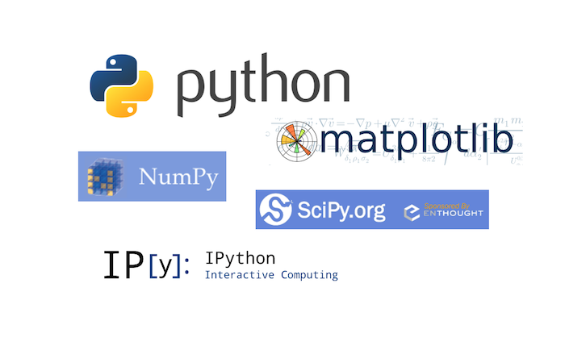

Math and unit functionality
aide_design

Slide 6

Jupyter accesses files stored locally on your computer

Slide 7

The Internet as storage

Slide 8

Desktop

Slide 9

What this means for you: How to begin working on your design challenges

Slide 10
1
Open GitHub Desktop, fetch/pull all changes from the CEE4540_DC repository to ensure you are working from the correct file.
Desktop
2
In your local computer, go to the following location in your files:
Documents -> GitHub -> CEE4540_DC
and copy the DC you will be working on.
Continuing through your local files, paste the DC into your private repository

Slide 11
Desktop

Slide 12
3
In GitHub Desktop, commit/push the ‘change’ you made by adding the DC file to your private repository. Make sure you are in your repository instead of CEE4540_DC
Desktop

Slide 13
Desktop

Slide 14

4
Open Anaconda
5
Launch Jupyter, make your way to the DC you just copied, and begin the fun!

Slide 15
Desktop

Slide 16
As of now you should be able to access DC Python Tutorial

Slide 17
And that means you have all the tools to finish it

Slide 18
Start early!

Slide 19
Like, today

Slide 20
It’s Friday at 1pm. So if you don’t do it now, you’re not gonna do it today

Slide 21
So get started, write some code!

